Slide 1
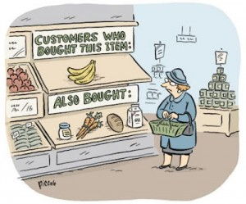
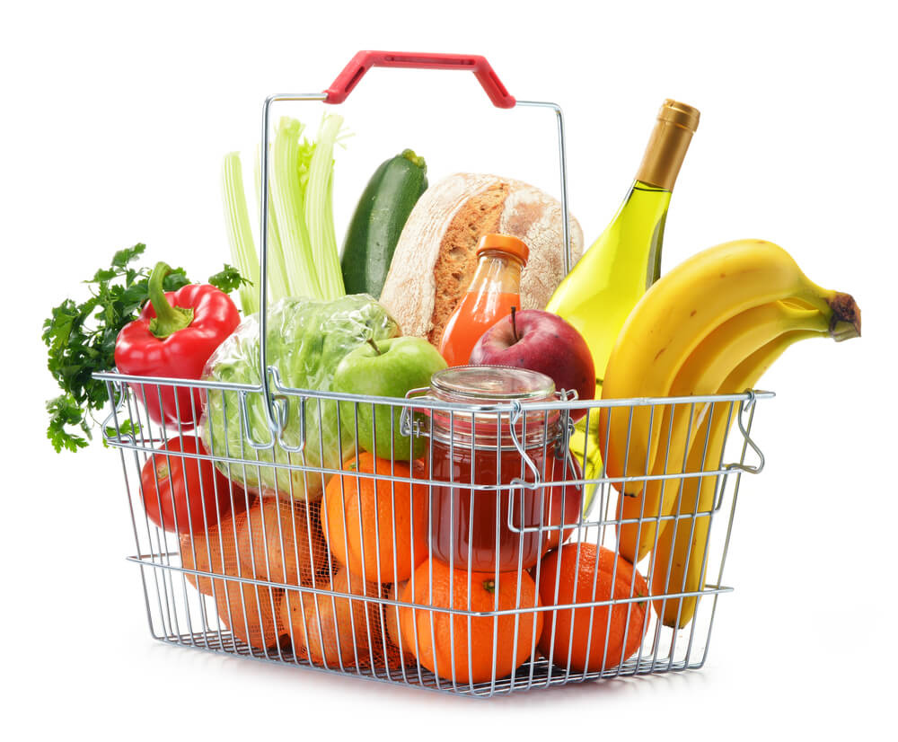
MARKET BASKET ANALYSIS

Slide 2
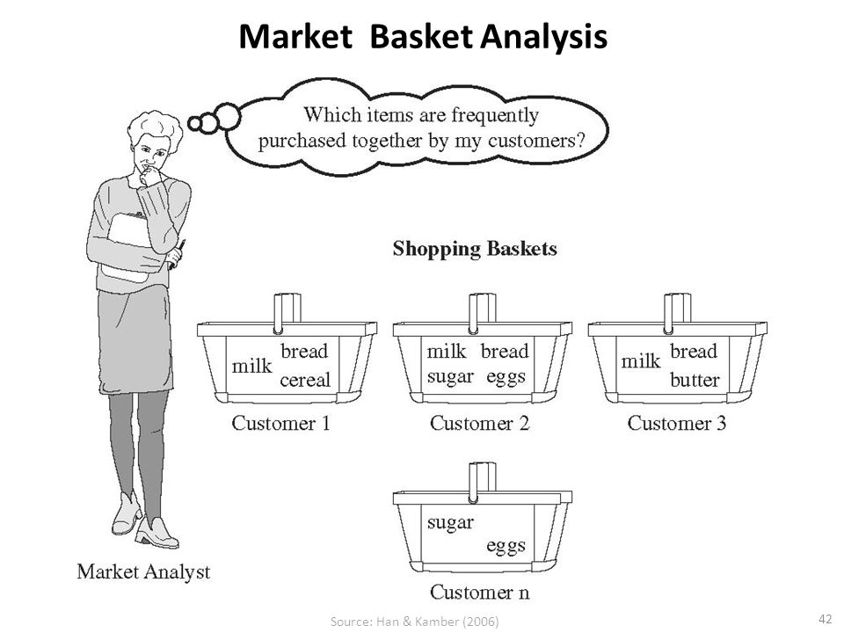
What is Market Basket Analysis
Suppose a consumer visits a store, if he /she buys product A and also product B and C.
Few more consumers visit the same store some buy product A and B only, some buy B & C only and some A & C.
Now that store manager wants to know the products sold together e.g. bread and butter.
Placing those products adjacent to each other can further increase the sales and would be ease for consumers also.
To find out these insights of consumers, Market Basket Analysis is used. It is a modelling technique based upon the theory that if a customer buys a certain group of items, he / she is more (or less) likely to buy another group of items.

Slide 3
Market Basket Analysis (MBA)
Each customer purchases different set of products, different quantities, different times
MBA uses this information to:
  Identify who customers are (not by name)
  Understand why they make certain purchases
  Gain insight about its merchandise (products):
    Fast and slow movers
    Products which are purchased together
    Products which might benefit from promotion
  Take action:
    Store layouts
    Which products to put on specials, promote, coupons…
Combining all of this with a customer loyalty card it becomes even more valuable

Slide 4
Why Market Basket Analysis
Cross Selling: Offering associated items.
Product Placement: Placing the associated items near to each other. If consumer sees them, it has higher probability that they will purchase them together.
Affinity Promotion: Designing the promotional events based on the associated products.
Fraud detection: Based on data, it may be possible to detect certain purchase behavior that can be associated with fraud.
Consumer Behavior: Associating purchase with demographic, and socio economic data (such as age, gender and preference) may produce very useful results for marketing.

Slide 5
Some Definitions
Transaction: Transactions are the group of items co-occurring together.
Confidence: It is the measure of uncertainty or trust worthiness associated with each discovered pattern. Mathematically, it is the percentage of transaction that contain both X and Y items out of all the transactions that contain X item.
Support: It is the measure of how often the collection of items in an association occur together as percentage of all transactions. For example, out of total transactions, if 60% transactions contain itemset {bread, butter}, then the support of {bread, butter} is 60%.
Frequent items: The items that appear together often enough. The term ‘often enough’ is formally defined with minimum support criterion.
Strong Association Rule: Rules that satisfy both a minimum support threshold and a minimum confidence threshold.

Slide 6
Q1
Min_support = 60% , min_confidence = 80%
id | Items
T100 | {M,O,N,K,E,Y}
T200 | {D, O , N, K, E, Y}
T300 | {M, A, K, E}
T400 | {M, U , C, K, Y}
T500 | {C, O, O, K, I, E}

Slide 7
Step 1
item | Support
M | 3 √
O | 4 √
N | 2 ×
K | 5 √
E | 4 √
Y | 3 √
D | 1 ×
A | 1 ×
U | 1 ×
C | 1 ×
I | 1 ×
Generate a cluster with minimum support.
Support = min_sup/100 * 5 = 60/100 * 5 = 3
All the element we need to drop down upto 3.
Drop out all values less than 3.
We transfer the same into another clustser.

Slide 8
Step 2
Compare the min_support with C1: temporary cluster L1 is created for below table
item | Support count
M | 3
O | 4
K | 5
E | 4
Y | 3

Slide 9
Step 3
Generate the new cluster C2
item | support
{M, O} | 1 ×
{M, K} | 3 √
{M ,E} | 2 ×
{M, Y} | 2 ×
{O, K} | 3 √
{O,E} | 3 √
{O, Y} | 2 ×
{K, E} | 4 √
{K, Y} | 3 √
{E, Y} | 2 ×

Slide 10
Step 4
Compare with min_sup with c2
Item | support
{M, K} | 3
{O, K} | 3
{O, E} | 3
{K, E} | 4
{K, Y} | 3

Slide 11
Step 5
Generate pairs for c3:
item | Support cnt
{M,K,O} | 1
{M, K, E} | 2
{N, K, Y} | 2
{O, K, E} | 3
{O, K, Y} | 2

Slide 12
Step 6 & 7
Compare c3 with min sup.
Creating association rules with min support and min confidence for {O, K ,E}.
n! = 3! = 3*2*1 = 6 this implies
O^K => E
O ^ E =>k
Condifence = support/
no.of occurace of pattern
Association rule | Support | Confidence | Confidence in %
O^K =>E | 3 | 3/3 = 1 | 100
O^E =>K | 3 | 3/3 =1 | 100
K^E =>O | 3 | ¾ = 0.75 | 75
E=> O^K | 3 | ¾ = 0.75 | 75
K=> O^E | 3 | 3/5 =0.6 | 60
O=>K^E | 3 | ¾ = 0.75 | 75

Slide 13
Interpretation
Hence final association rules are :
O^K => E
O^E => K

Slide 14
Apriori Algorithm cont.
Apriori principle:
If an itemset is frequent, then all of its subsets must also be frequent
Suppose A,B,C,D, E are items. Then total combinations possible for these items are shown in the figure. This figure illustrates how the Apriori works.
If itemset {B,C,D} is frequent, then all the subsets of this itemset, highlighted, must also be frequent itemsets. This provides the basis for Apriori algorithm.
Apriori principle holds due to the following property of the support measure:
The support of an itemset never exceeds the support of its subsets
This is known as the anti-monotone property of support

Slide 15
Apriori Algorithm cont.
The Apriori algorithm takes a bottom-up iterative approach to uncover the frequent itemsets by first determining all possible items and then identifying which among them are frequent.
Assuming the minimum support threshold (or minimum support criterion) is set at 0.5, the algorithm identifies and retains those itemsets that appear in at least 50% of all transactions and discards the itemsets that have support less than 0.5 or appear in less than 50% of the transactions.
In the next iteration, the identified frequent 1-itemsets are paired into 2-itemsets and again evaluated to identify the frequent 2-itemsets among them.
At each iteration, the algorithm checks whether the support criterion can be met; if it can, the algorithm grows the itemset, repeating the process until it runs out of support or until the itemsets reach a pre-defined length. Apriori algorithm in mathematical form is given in next slide.

Slide 16
Apriori Algorithm cont.
Let
C_{K} : Set of candidate k-itemsets
L_{K} : Set of k- itemsets that satisfy the minimum support
D : Transaction database
δ : Minimum Support threshold
N : Optional parameter indicating the maximum length an itemset could reach
Apriori iteratively computes frequent itemsets L_{k+1} based on L_{K}.
Apriori (D , δ, N)
K 1
L_{K} { 1 – itemsets that satisfy minimum support δ }
While L_{K} ≠ Ø
if Ǝ N V (Ǝ N ^ K < N)
Ck candidate itemsets generated from L

Slide 17
Apriori Algorithm
For each transaction t in database D do
Increment the counts of C_{K} contained in t
L_{K} candidates in C_{K} that satisfy minimum support
K k+1
Return U_{k}L_{k}
The first step is to identify frequent itemsets that meet the predefined minimum support threshold δ. These itemsets are 1-itemsets denoted as L₁, as each 1-itemset contains only one item.
Next, the algorithm grows the itemsets by joining L₁ onto itself to form new, grown 2-itemsets denoted as L and determines the support in each 2 itemsets in L₂. Those itemsets that do not meet minimum support threshold δ are pruned away.
Once completed, the output of algorithm is the collection all the frequent k-itemsets.

Slide 18
Applications of Association Rules
Broad-scale approaches to better merchandising – what products should be included or excluded from the inventory each month.
Cross-merchandising between products and high-margin high ticket items.
Physical or logical placement of product within related categories of products.
Promotional programs – multiple product purchase incentives managed through a loyalty card program
Apart from market Basket analysis, association rules are also commonly used for recommender systems (Amazon and Netflix) and clickstream (web browsing user clicks) analysis.

Slide 19
Use Case - description
Mike is store manager of a Multi brand retail store. He has access to the transactions data stored every time a customer buys something from his stores. He knew by experience that certain products are often bought together but with huge variety of products available, he wanted to perform some statistical test to capture the insightful association available in the transaction records available in his database.
He had plans to re-design the store layout so that customers find the associated products next to each other. He wanted to rethink over the offers and promotions to ensure that they make sense to the customers. Finally, this basket analysis will help him proactively recommend “What else” and “What next” to his loyal customers.
Mike will perform Market basket analysis and based on the output results, plan his store layout, promotions and recommendations.

Slide 20
Interpretation
Conclusion:
Based on the above results we can say the whenever Product A and Product I will be bought together, there are high chances that product E will also be bought. Similarly we can interpret the other rows and plan the promotions or store layouts to catch customer’s attention.
Store layout (put products that co-occur together close to one another, to improve the customer shopping experience)
Marketing (e.g. target customers who buy flour with offers on eggs, to encourage them to spend more on their shopping basket)
Online retailers and publishers can use this type of analysis to:
Inform the placement of content items on their media sites, or products in their catalogue
Drive recommendation engines (like Amazon’s customers who bought this product also bought these products…)
Deliver targeted marketing (e.g. emailing customers who bought products specific products with other products and offers on those products that are likely to be interesting to them.

Slide 21
Thank You!

